Slide 1


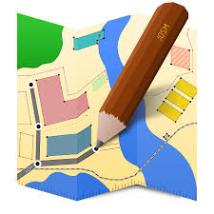

Introduction to JOSM

Slide 2
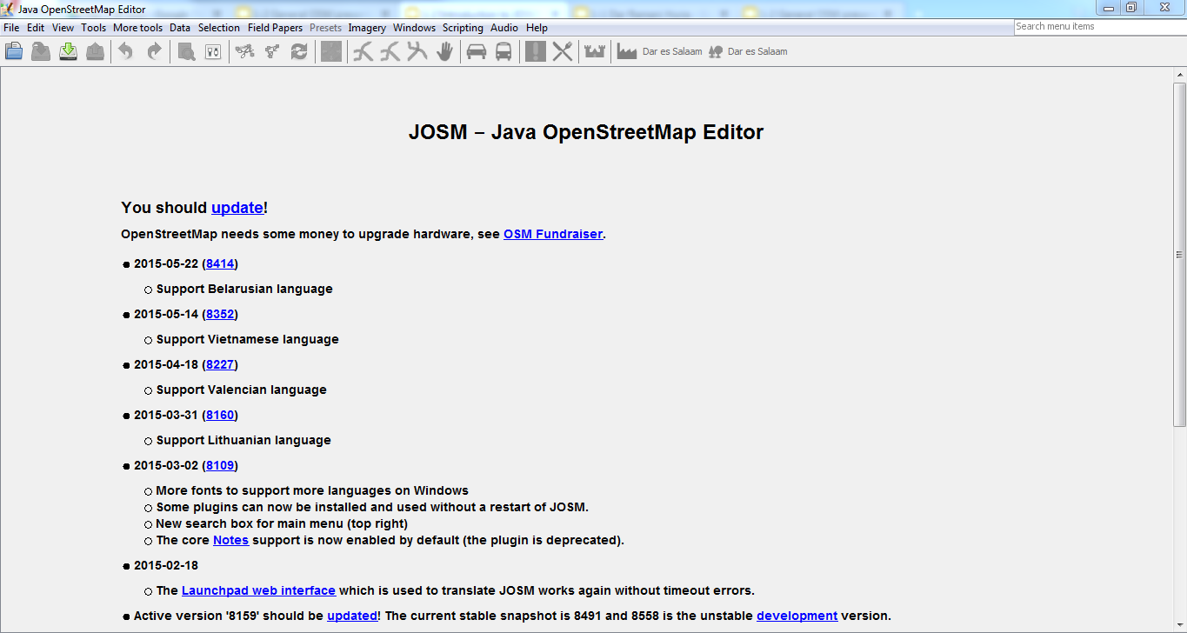
What is JOSM
Open source OpenStreetMap editor
Works on offline data, synced by the user (download data/upload), so data usage is limited

Slide 3
JOSM workflow
Download data from OSM
Or import it, for example from OpenMapKit!
Set up your workspace; decide which imagery to use
Add, edit or delete nodes and ways
Draw new nodes, edit tags, etc
Upload data to ‘save’ it to OSM

Slide 4
Install JOSM
Get a copy from the USB Stick from the facilitator. Copy the “JOSM install” folder.
Install the Java runtime (jre-8u45-windows-i586.exe)
Install JOSM
Open a file explorer window
Type %APPDATA% in the location bar
Copy the “JOSM” folder to this directory. This will install plugins.
Type C:\ProgramData in the location bar
Copy the “JOSM_presets” folder to this directory. This will install the presets.
Launch JOSM.

Slide 5
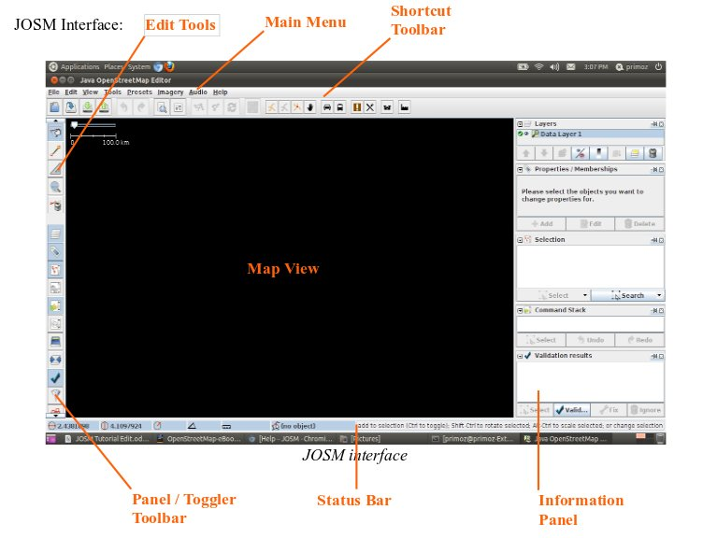

Slide 6
JOSM Interface
Map View – The main window where the geodata is displayed and editing takes place
Main Menu – The menu is customizable depending on which plugins you have installed
Shortcut Toolbar – The buttons in this toolbar are shortcuts to commands from the Main Menu. This toolbar is highly customizable, with the ability to add and remove menus items from the preference dialog.

Slide 7
Edit Tools – Contains drawing tools and the show/hide buttons for the Toggle Dialogs window
Information Panels – These show information about the data in JOSM, including a list of selected features, objects, how the selected objects are tagged, who the last mapper to edit a feature was, and the different layers in the view
Status Bar – Gives coordinates and measurements for features, as well as a hint of the current tools

Slide 8
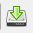
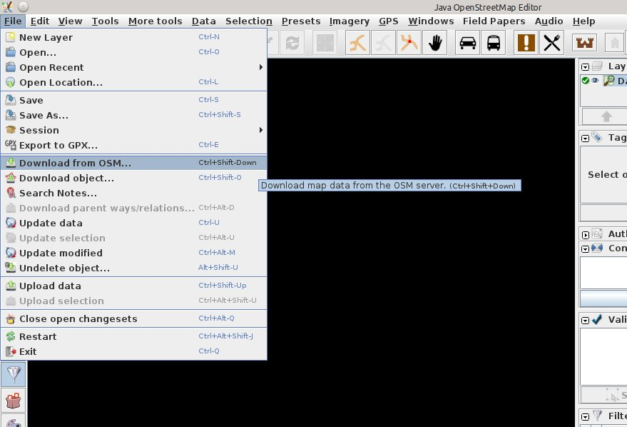
Click File > Download from OSM (or the icon on the Main Toolbar)
Downloading Data into JOSM from OSM Servers

Slide 9
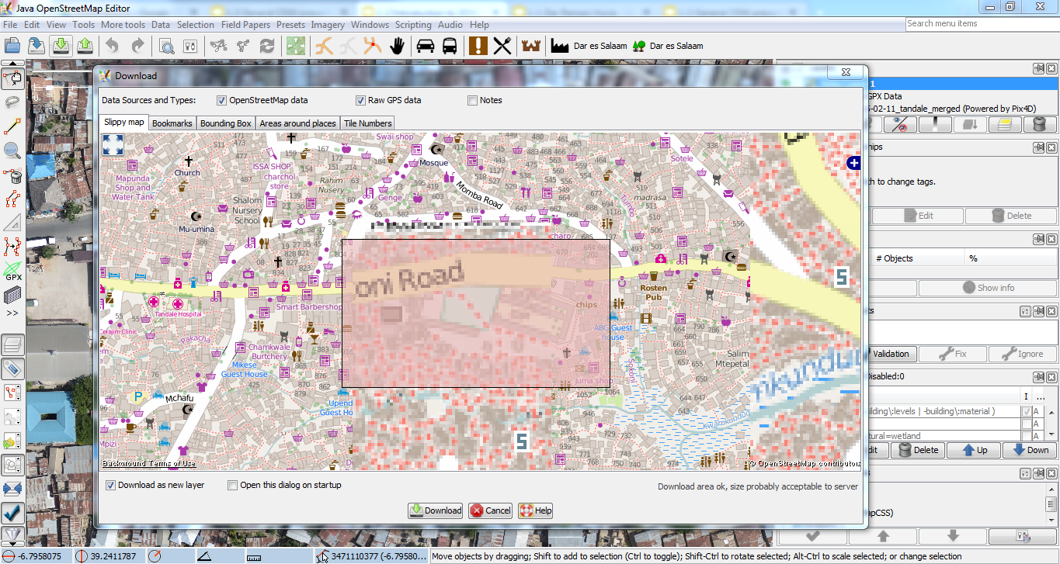
The download dialog box appears (Slippy Map)
Hold your left mouse button, drag to create a light pink box. This will be the data that will be downloaded into JOSM.
NB: Don’t download large portions of data because it may take a long while. Work with smaller portions, and after you’re done, you download another portion. You can always choose to download additional data!

Slide 10
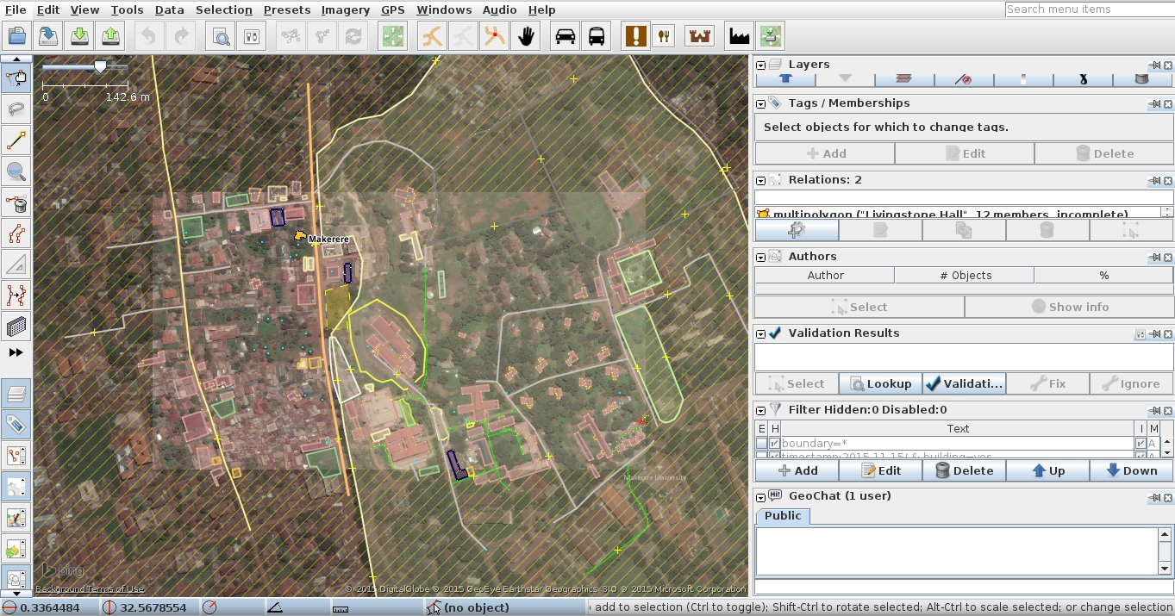
Press the button
Download Data should appear in the main Map View Window
The cross hatched area is to remind you that you should not edit outside the area that you download from the server.

Slide 11
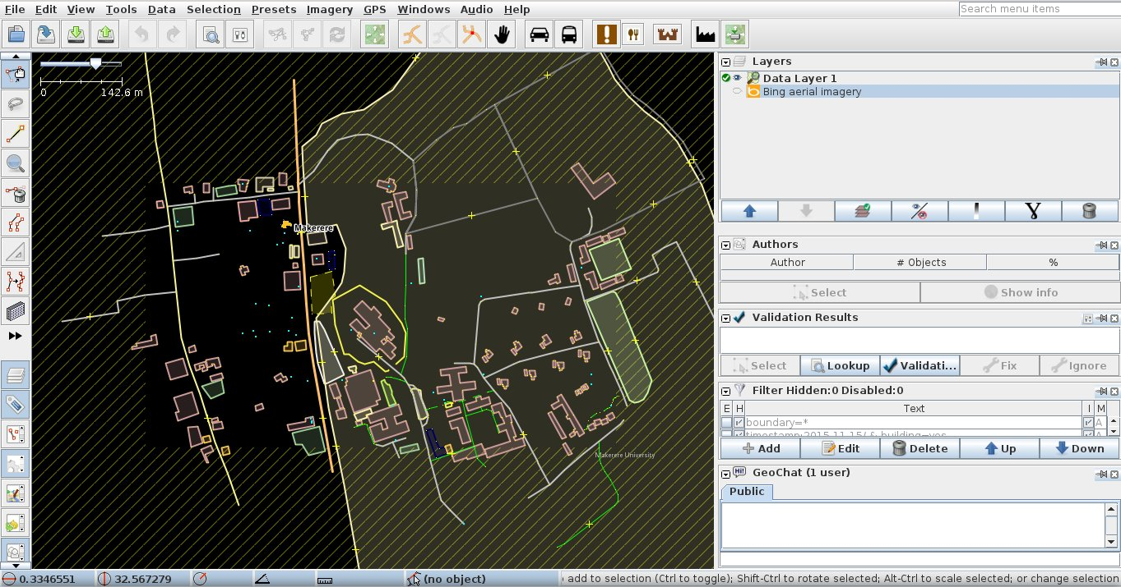
Downloaded data in JOSM
You can activate and deactivate the visibility of any layer, change the order of alignment, increase and decrease its transparency, merge a previously downloaded layer with a new one (Data Layer 1 and Data Layer 2 into one layer), Duplicate Layer and Delete.

Slide 12
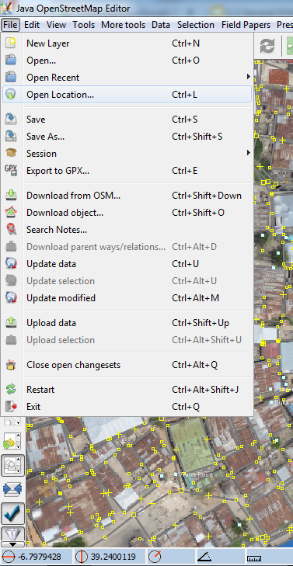
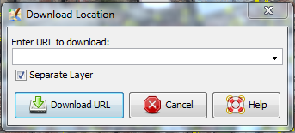
Downloading Data from OSM
There are other ways to specify the area you want to download:
Download data by pasting the url from OpenStreetMap site into JOSM File>Open Location or Ctrl + L

Slide 13
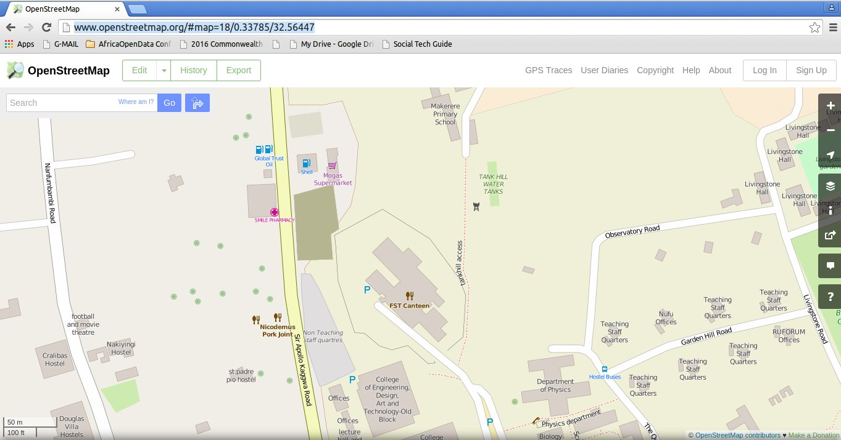
Copy the URL

Slide 14
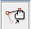
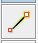

Once downloaded
Basic navigation:
Right mouse button: drag the map
Left mouse button: manipulate an element
Scroll wheel: zoom in/out
There are three main modes of operation when editing:
(S)elect for selecting elements, viewing/editing their tags and moving them.
(A)dd for adding elements, such as standalone nodes, adding new nodes to create a new way, or extend an existing way.
Delete (Ctrl+Delete) for deleting elements.

Slide 15
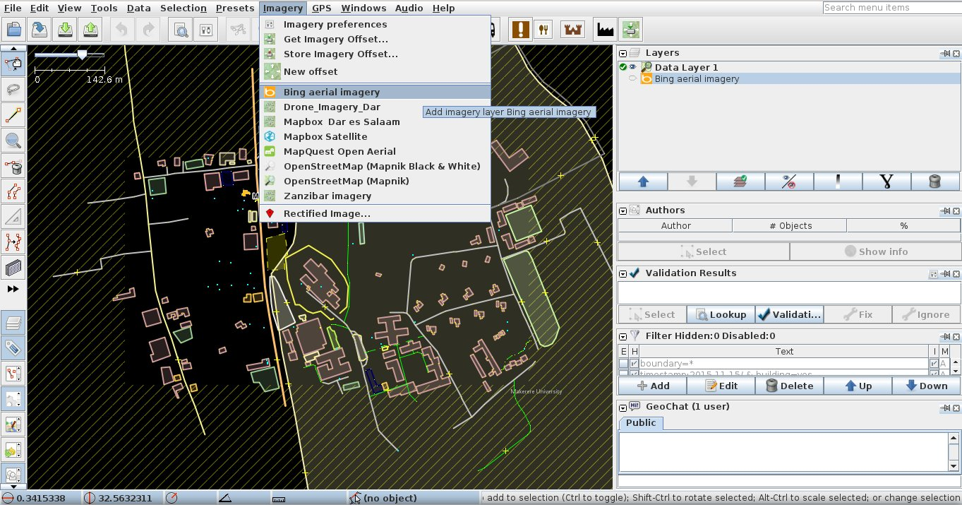
Adding Imagery
To add the Bing satellite imagery in JOSM, click “Imagery” on the top menu of JOSM and selecting “Bing Sat.”

Slide 16
Drawing basic elements
Nodes: The dots that are used to mark specific locations or for drawing the segments between these locations. Nodes are points in space. Each node has a latitude and longitude
Ways: An ordered list of nodes, displayed as connected by line segments. They are used to describe roads, paths etc
Closed Way or Area: Closed ways are ways which go in a closed loop. Used to describe areas (like parks, lakes, islands or buildings).

Slide 17
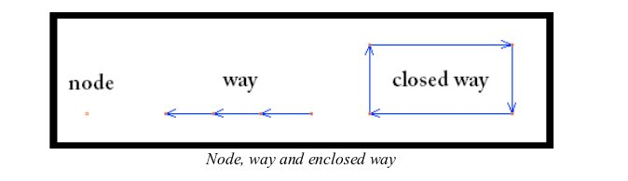
Drawing basic elements

Slide 18

Drawing a node
To draw a standalone node:
Clear your current selection by pressing Edit > Unselect All or press Escape button on your computer
Press 'A' or select the Draw Nodes to begin drawing a node
Press the Left Mouse Button somewhere in the Map View Window and press Escape
Double Click to create a node
Return to Select mode

Slide 19
Drawing a way
Press again somewhere and another node will appear, joined by the first segment of a way
Keep pressing to draw a way with several nodes and segments on it
To stop go back to Select mode or press 'S' or Escape button on your computer

Slide 20
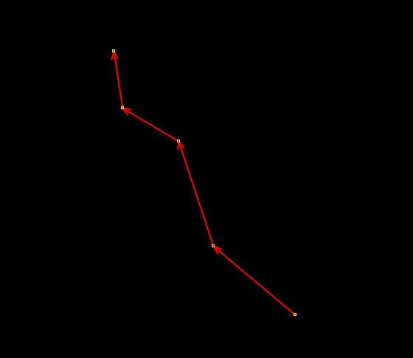
A way

Slide 21
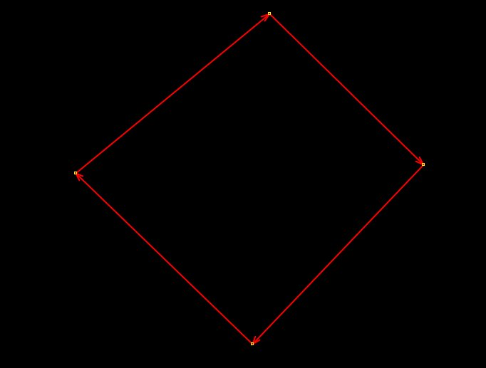
A closed way

Slide 22
Tags
Tags describe geographic data in OpenStreetMap.
Tags are attributes (or descriptions) you attach to basic elements (nodes, ways, closed ways/areas)
A Tag is a Key = Value pair
Key is a string describing the general classification of the feature. The Value gives more specific information within the class Key
Keys and generic Values are lower case and do not including space, use underscore instead.

Slide 23
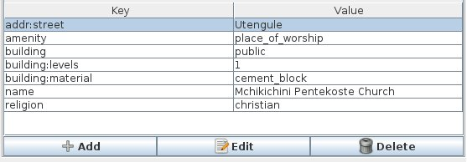
Tagging
In JOSM tags are displayed on the right side under “properties/memberships”. Selecting an element displays the table with key and value fields
Tags for a selected object

Slide 24
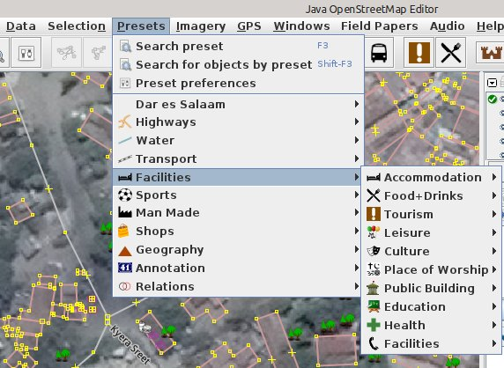
Presets
A preset is a tag that is given a “human-readable”name. Presets allow the user to tag objects by selecting them from the predefined menu.
In JOSM go to
Main Menu
and press
Presets

Slide 25
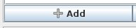
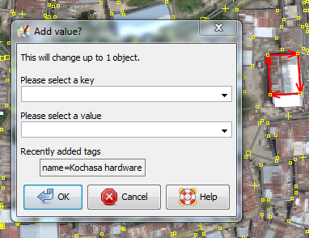
Presets/Tag
Add a tag by using an “Add” button:
Press the button Add a Tag
Change values window appears where you can select a key or a value from the drop-down list. The drop-down list contains all the values in the downloaded area and all the know tags or presets. Add a tag by using predefined

Slide 26
Presets
Select an entry from Presets by pressing Presets tab on the Main Menu
Select an entry from the drop-down
Select the attributes
Press Apply Preset

Slide 27
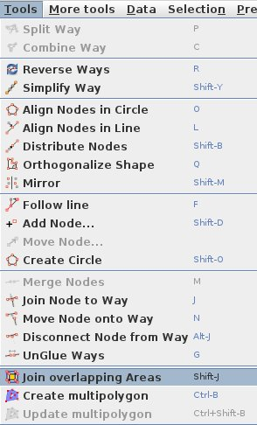
JOSM in Detail
JOSM has some additional tools to make it easier to draw lines and shapes. These tools are found in the Tools menu at the top of JOSM.

Slide 28
Advanced Editing Tools
Split Way
Combine Way
Reverse Way
Simplify Way
Create Circle OR Align Nodes in Circle
Orthogonalize Shape
Unglue Ways

Slide 29
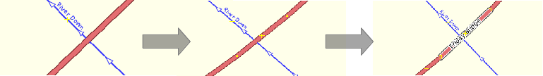
Split Way
This allows you to divide a line into two separate lines. Useful if you want to add different attributes to different parts of a road, such as a bridge. To use this function, select a point in the middle of the line that you want to split, go to Tools ‣ Split Way and your line should be split in two.

Slide 30
Combine Way
This does the opposite of Split Way. To combine two lines into a single line, they must share a single point. To use this function, select both lines that you want to combine.
You can select more than one object by holding the SHIFT key on your keyboard and clicking on each line.

Slide 31
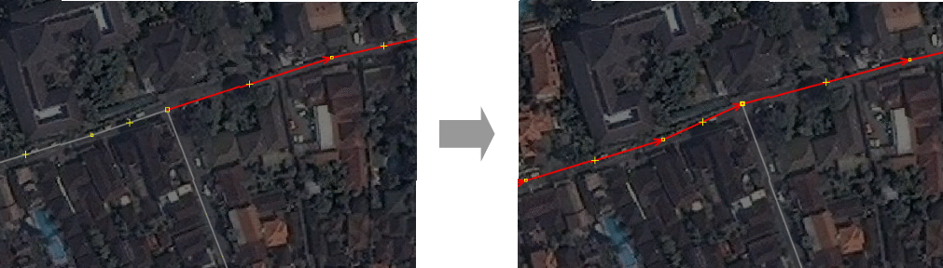
Combine Way
Combine Way
Combine Way
When you have selected both lines, go to Tools ‣ Combine Way.

Slide 32
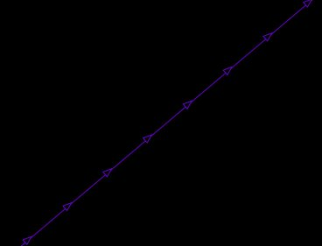
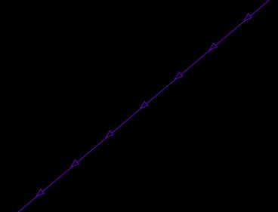
Reverse Way
This will change the direction of the line. If the line incorrectly represents a road or river that is one-way, you may want to change its direction. To Reverse Ways select the way, then go to Tools ‣ Reverse Way

Slide 33
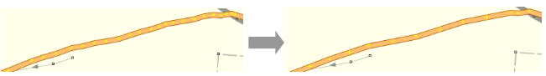
Simplify Way
If your line has too many nodes in it and you’d like to make it simpler, this will remove some of the points from a line. Select the way, then go to Tools ‣ Simplify Way

Slide 34
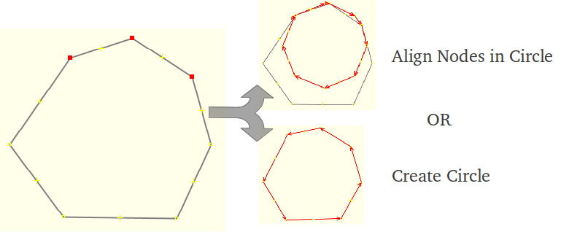
Align Nodes in Circle OR Create Circle
If you are trying to make a circular shape, draw the circle as best you can and then select three nodes and the function. It will help arrange your points in a circle. Select the way then go to Tools ‣ Align Nodes in Circle OR Select at least three nodes then go to Tools ‣ Create Circle

Slide 35
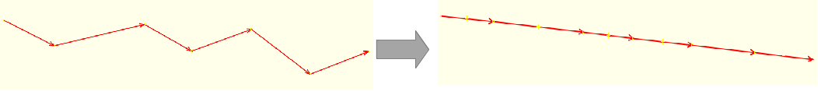
Align Nodes in Line
This function will align a series of points into a straight line. With long lines it is best to select sections of the line to straighten. Be careful as this does have the tendency to shift the line a little. To do this, select the line then go to Tools ‣ Align Nodes in Line

Slide 36
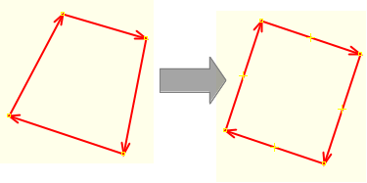
Orthogonalize Shape
This function is very useful for drawing regular shapes such as buildings. After you draw an area, this function will reshape it to have square corners. This feature is most useful for other regularly shaped features, such as tennis courts or landuse areas. To do this, select the object then go to Tools ‣ Orthogonalize shape or simply press the shortcut Q

Slide 37
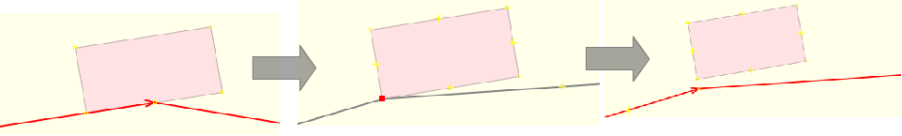
Unglue Ways
This tool allows you to detach nodes that are connected. To do this, select either a node or one of the ways glued together, then go to Tools ‣ Unglue Ways

Slide 38
Plugins
JOSM allows you to install numerous plugins, which add extra functionality to the software.
Installing plugins
Buildings plugin
mbtiles
Utilsplugin2 (More Tools)

Slide 39
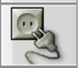
Install plugins
To install plugins to Edit > Preferences and click on the Plugins tab.
You will see a list of available plugins.
To install a plugin you simply must check the box next to it and click OK at the bottom.
Lastly, you must restart JOSM anytime you install new plugins.

Slide 40
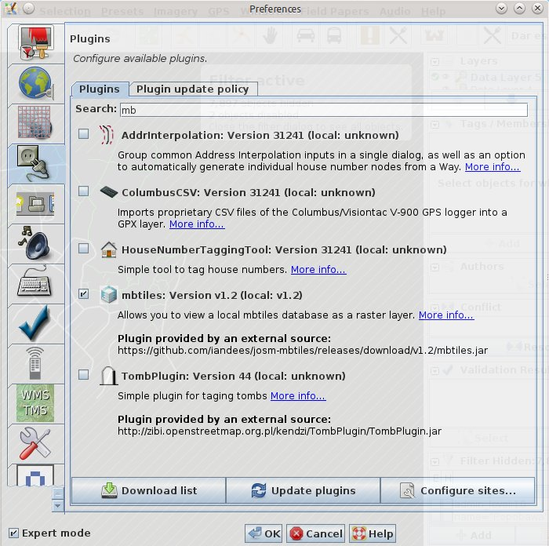
Install plugins

Slide 41
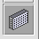
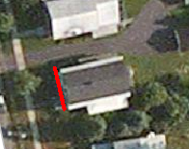
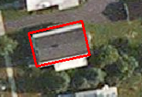
Building plugin
Buildings_tools is simple plug-in for drawing rectangular buildings.
This plugin is by far one of the most useful tools for editing. After installation, It will appear as an icon on the left.
The Building tool allows you to create shapes with 90 degree corners with just three clicks. First, trace the edge of the building and then drag out the line to make it a polygon.

Slide 42
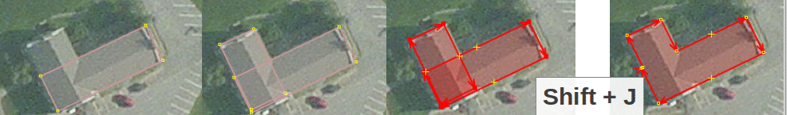
Join overlapping Layers
You can also create more complicated buildings by using the merge option. Create your building outline, select all of the polygons (press SHIFT to highlight them all) and then press SHIFT + J to merge the objects.

Slide 43
mbtiles
The mbtiles plugin allows you to view a local mbtiles database as a raster layer.
To install mbtiles, go to Edit > Preferences>Configure Plugins
Search for mbtiles, check the box on the left and click ok
You must restart your computer for the plugin to be active

Slide 44
Install plugins

Slide 45
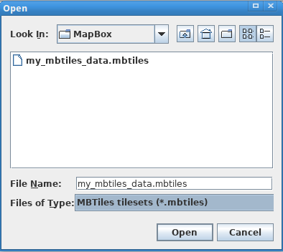
mbtiles
To use mbtiles in JOSM
Go to File > Open > "Files of Type" drop down list to select the "MBTiles tilesets(*.mbtiles)" file type.
Pick your tileset.
Use the Layers window to turn the images on and off just like any other imagery layer.

Slide 46
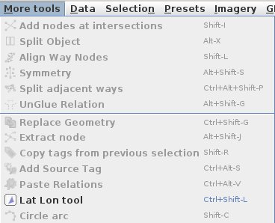
utils plugin 2
The plugin utilsplugin2 has several features that are also useful for editing.
After you install this plugin, a new menu will appear called More Tools.
Some of the most useful tools here are:
Add Nodes at Intersections
Copy Tags from Previous Selection
Replace Geometry

Slide 47
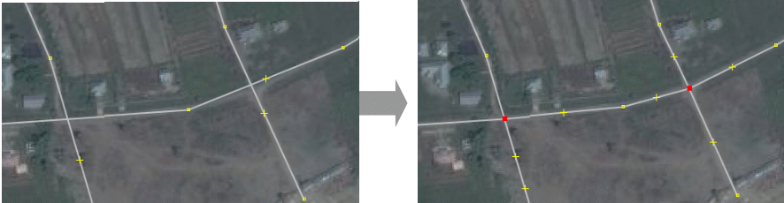
Add Nodes at Intersections
This tool is helpful for adding missing nodes in intersections of selected ways. It is good practice that roads and rivers should always have common nodes where they intersect. Select all the ways, then go to More Tools ‣ Add nodes at intersection

Slide 48
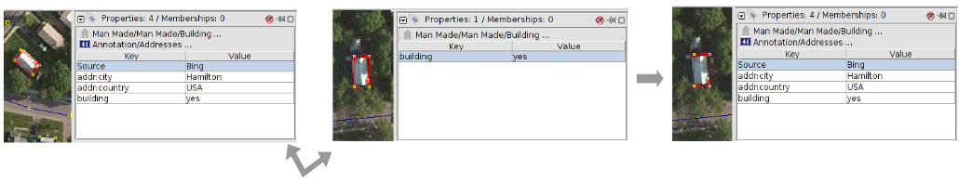
Copy Tags from Previous Selection
This function makes copying tags easier. If you want to create many objects with the same tags, first draw the objects. Then add the tags to one object. Click on another object and press Shift + R to copy the tags from the previously selected object. You can do this for all objects that you want to tag.
Note that the tags will be copied from the previously selected object.

Slide 49
Replace Geometry
This tool is to redraw a poorly shaped object, when you want to keep the history, attributes and ID number of that object.
For example, if you come across a building that is complicated and drawn in a poor fashion, then instead of painfully changing each node, you can just draw the object again select the old and new object press More Tools ‣ Replace Geometry to transfer all the information over.

Slide 50
JOSM Filters
JOSM Filters allow you to disable, hide, select, and highlight specific groups of objects based on flexible custom parameters.
To work with filters, turn on the filters panel (Windows→Filter from the menu, or Alt+Shift+F from the keyboard). Use the +Add button on this panel to create a new filter. The filter creation window looks like this:

Slide 51
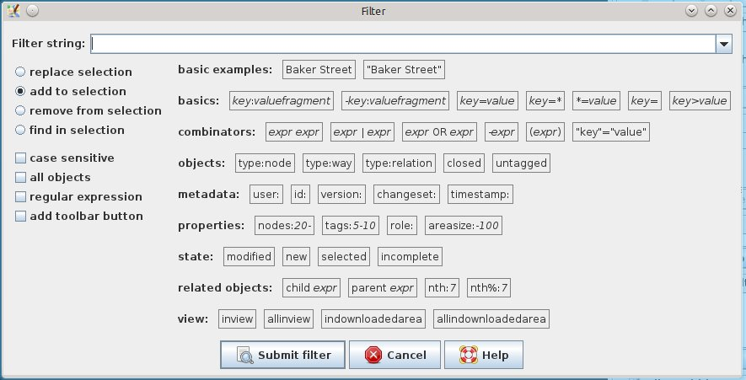
JOSM Filters

Slide 52
JOSM Filters
For example, to filter the data layer to show only roads: Add the following filter
highway=*
then click on Submit Filter

Slide 53
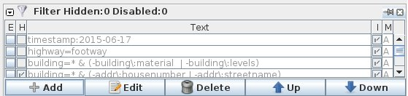
Filter Options
E (Enable): Enable or disable this filter line.
H (Hide elements): If this option is ticked, the chosen objects are completely hidden. Otherwise they are disabled and shown in a shade of gray.
Text: The search term or property that defines the objects that are filtered.
I (Inverse Filter): Normally, the specified objects are hidden and the rest is shown. If this option is activated, only the specified objects are shown and the rest is hidden.

Slide 54
Quality Assurance
As you map more and more it is crucial to learn the “proper” way to do things.
JOSM has a validation tool, which is automated to search for errors and warnings in your data.

Slide 55
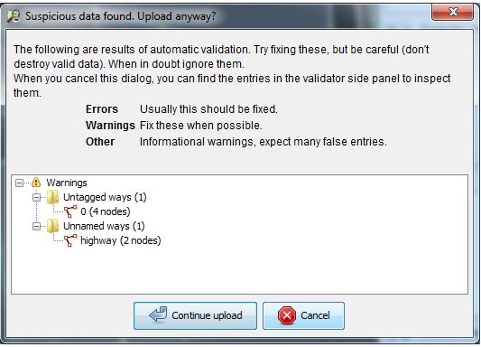
Errors and warnings
Sometimes when you go to upload your edits in JOSM you get a pop-up window like this:

Slide 56
Errors and Warnings
Errors: These are important to fix, and therefore usually you should not ignore these. Examples of errors include duplicated objects or overlapping lines and polygons.
Warnings: These are problems that are important to fix, but in some cases, they are tolerable.
NOTE: When you run the validation tool, you may get a very long list of errors and warnings. This is because the validation tool works on the whole map, not only the changes that you have made. You may see mistakes that other mappers have made, and you can fix them, or ignore them.

Slide 57
Common validation warnings
Ways that are not closed
Crossing buildings (overlapping buildings)
Untagged nodes or ways
End node near another way
Crossing ways

Slide 58
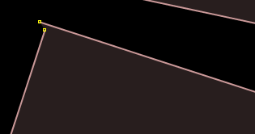
Ways that are not closed
This is usually a line that does not form a polygon. Common examples are buildings where the first node does not meet the last node.
To fix this, select both nodes and go to Tools ‣ Merge Nodes to connect them.

Slide 59
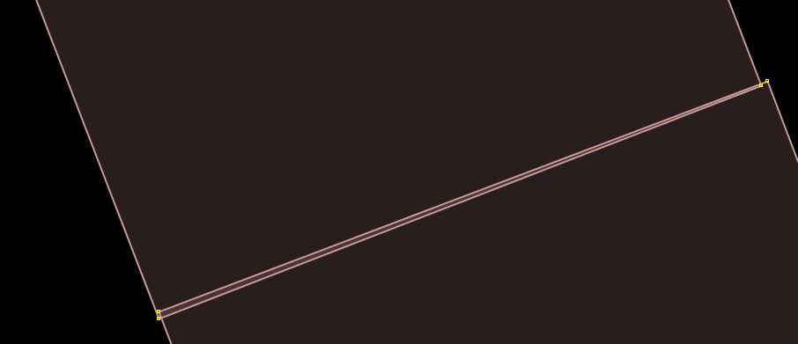
Crossing buildings (overlapping buildings)
This means that buildings are overlapping each other.
To fix this, move the nodes of one of the buildings outside of the other building. It is possible for two buildings to share nodes, if the buildings share a common wall. But two buildings cannot overlap with one another.

Slide 60
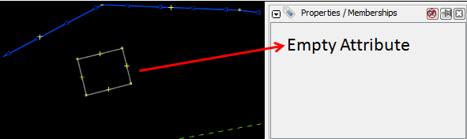
Untagged nodes or ways
If someone draws a point or a line but forgets to give it any tags, then it is useless, because it does not mean anything.
To fix this, apply tags to the object to identify it, or delete it if it is a mistake.

Slide 61
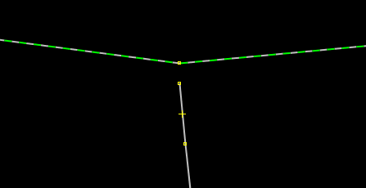
End node near another way
If a line ends very close to another line but does not connect, this raises a warning.
Many times this warning is not important, but it helps to find road intersections that are supposed to connect but do not.

Slide 62
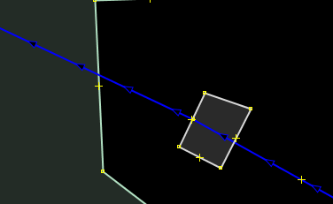
Crossing ways
Lines that cross other lines without being connected will raise warnings. Many times this is not a problem, because the crossing ways are intentional - such as in the case of bridges, or streets and rivers that cross landuse polygons. However, it is sometimes helpful to find errors.

